Slide 1
Directed study review
Thoughts about the reading?
How did you get on with the Data Journalism Heist?
Any story ideas?

Slide 2
WhoFundsThem!
Training was yesterday - watch/slides
Useful insight into a data collection/open data project (+ useful data)
E.g. marking guide, lit review
Slack channel for volunteers

Slide 3
Date for the diary! Dec 3-4
The JournalismAI Festival (online)
Subscribe to the newsletter for details on how to join.
Videos from last year on the YouTube channel

Slide 4


Data journalism:
The “3 chords”
MED7373 Data Journalism @PaulBradshaw
MA Data Journalism, Birmingham City University #bcujournos

Slide 5

“Data journalists are the new punks”

Slide 6
Data journalism’s 3 basic chords...
Sorting (ranking who’s worst/best)
Filtering (what’s relevant to my audience?)
Basic calculations (scale, change and percentages)

Slide 7
“You do know, right, that if you go into a newsroom tomorrow you are going to need to know how a pivot table works.
“Because you can build it in R, sure, but it needs to be very quick. You need to be very, very quick and on your toes and at least in the first instance describe it to the news editor.
“And then you can do some work.”
Pamela Duncan, The Guardian
Pamela Duncan, Data Journalism Podcast (2023), from 22’00

Slide 8
Data journalism's 3 chords
Here's a quick activity to get to grips with data journalism's '3 chords': sorting, filtering, and calculating percentages (change and proportions).
With just those 3 tools you can find and tell the most basic data journalism stories: who's top and bottom; what's changed; and what's of interest. And the good news is that two of them require no maths at all.
Some data to play with
First, you'll need some data to try out these techniques. Here are 3 useful datasets I'll refer to:
Donations to political parties (conduct a search and look for the data download link under the results)
Gender pay gap data
Local authority spending above £500 (Birmingham) (the most recent release is at the bottom)
Stop and search data (tick West Midlands and Include stop and search data). There's a GitHub repo for the data used in a story on Birmingham Eastside which you can use too - this has totals for two months that can be compared.
European Investment Bank: projects financed database (conduct a search and there will be a link to download the data)
Oscar winners (click the download button in the upper right corner)
In the repo...
https://github.com/paulbradshaw/MED7373-Data-Journalism/blob/master/1basics/dj3chords.md

Slide 9
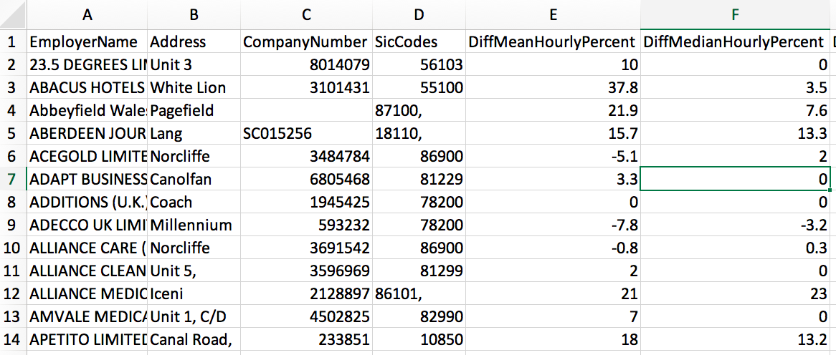
For example: gender pay gap data
https://gender-pay-gap.service.gov.uk/

Slide 10
Sorting and filtering to find stories
Sort it to bring outliers to the top
Filter it to identify organisations in a particular area or industry (further manual filtering may be required)
Filter — and then sort!

Slide 11
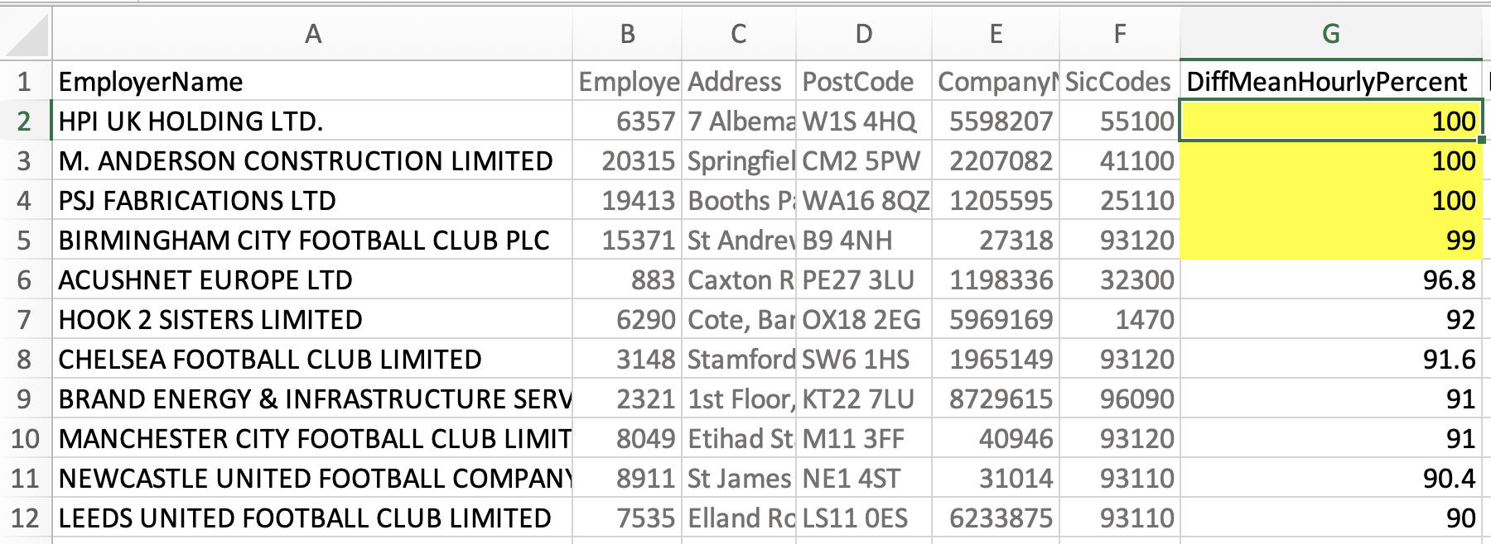
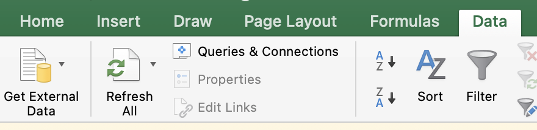
Sorted Z-A by mean pay gap
https://gender-pay-gap.service.gov.uk/

Slide 12
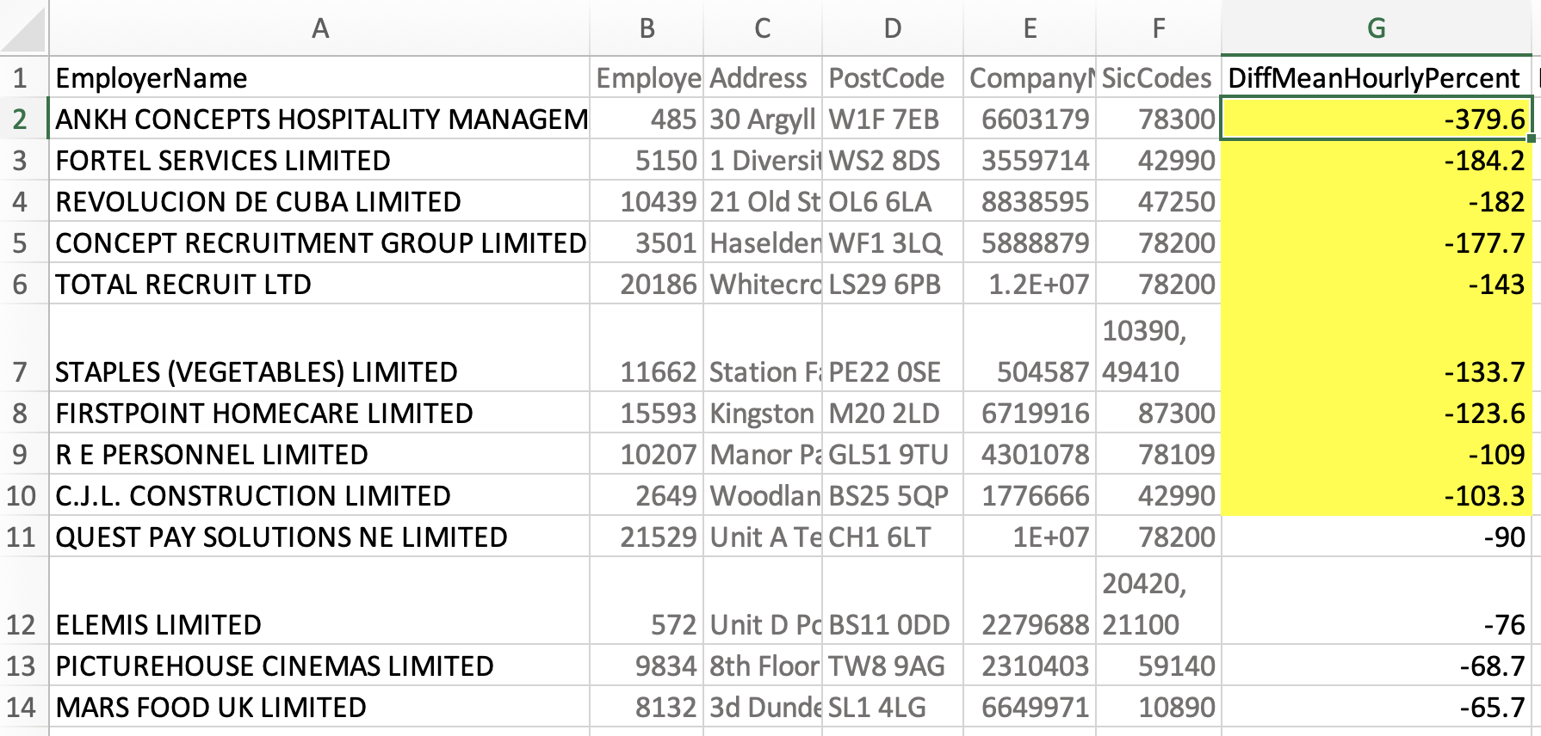
Sorted A-Z by mean pay gap
https://gender-pay-gap.service.gov.uk/

Slide 13
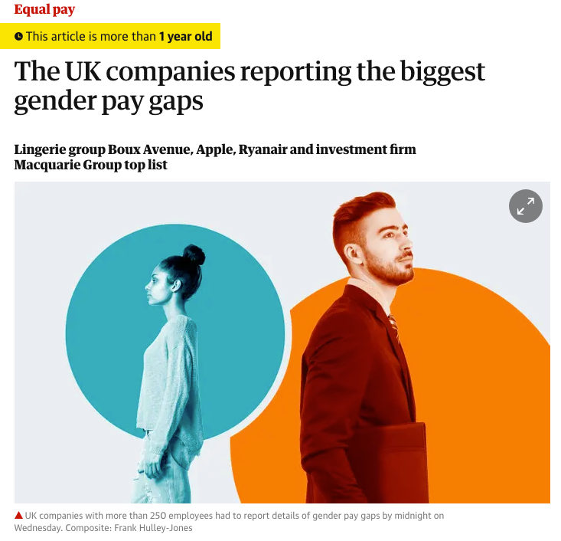
Sorting ‘reveals’ the worst/best companies
https://www.cosmopolitan.com/uk/reports/a27042068/gender-pay-gap-2019-best-worst-companies/
https://www.theguardian.com/society/2018/apr/05/the-uk-companies-reporting-the-biggest-gender-pay-gaps

Slide 14
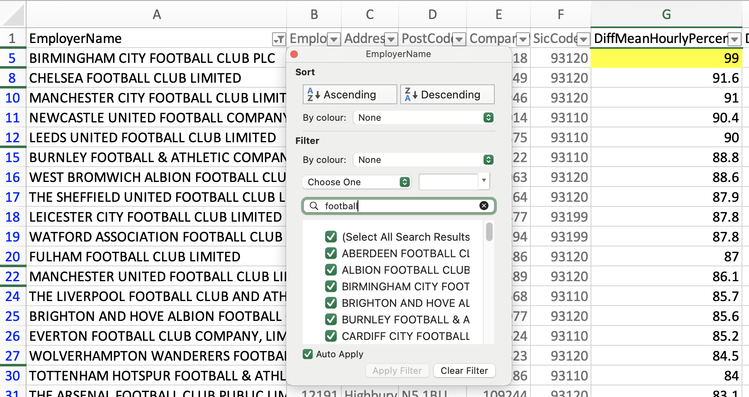
Sorted Z-A — and filtered
https://gender-pay-gap.service.gov.uk/

Slide 15
Sorted Z-A — and filtered
https://gender-pay-gap.service.gov.uk/

Slide 16
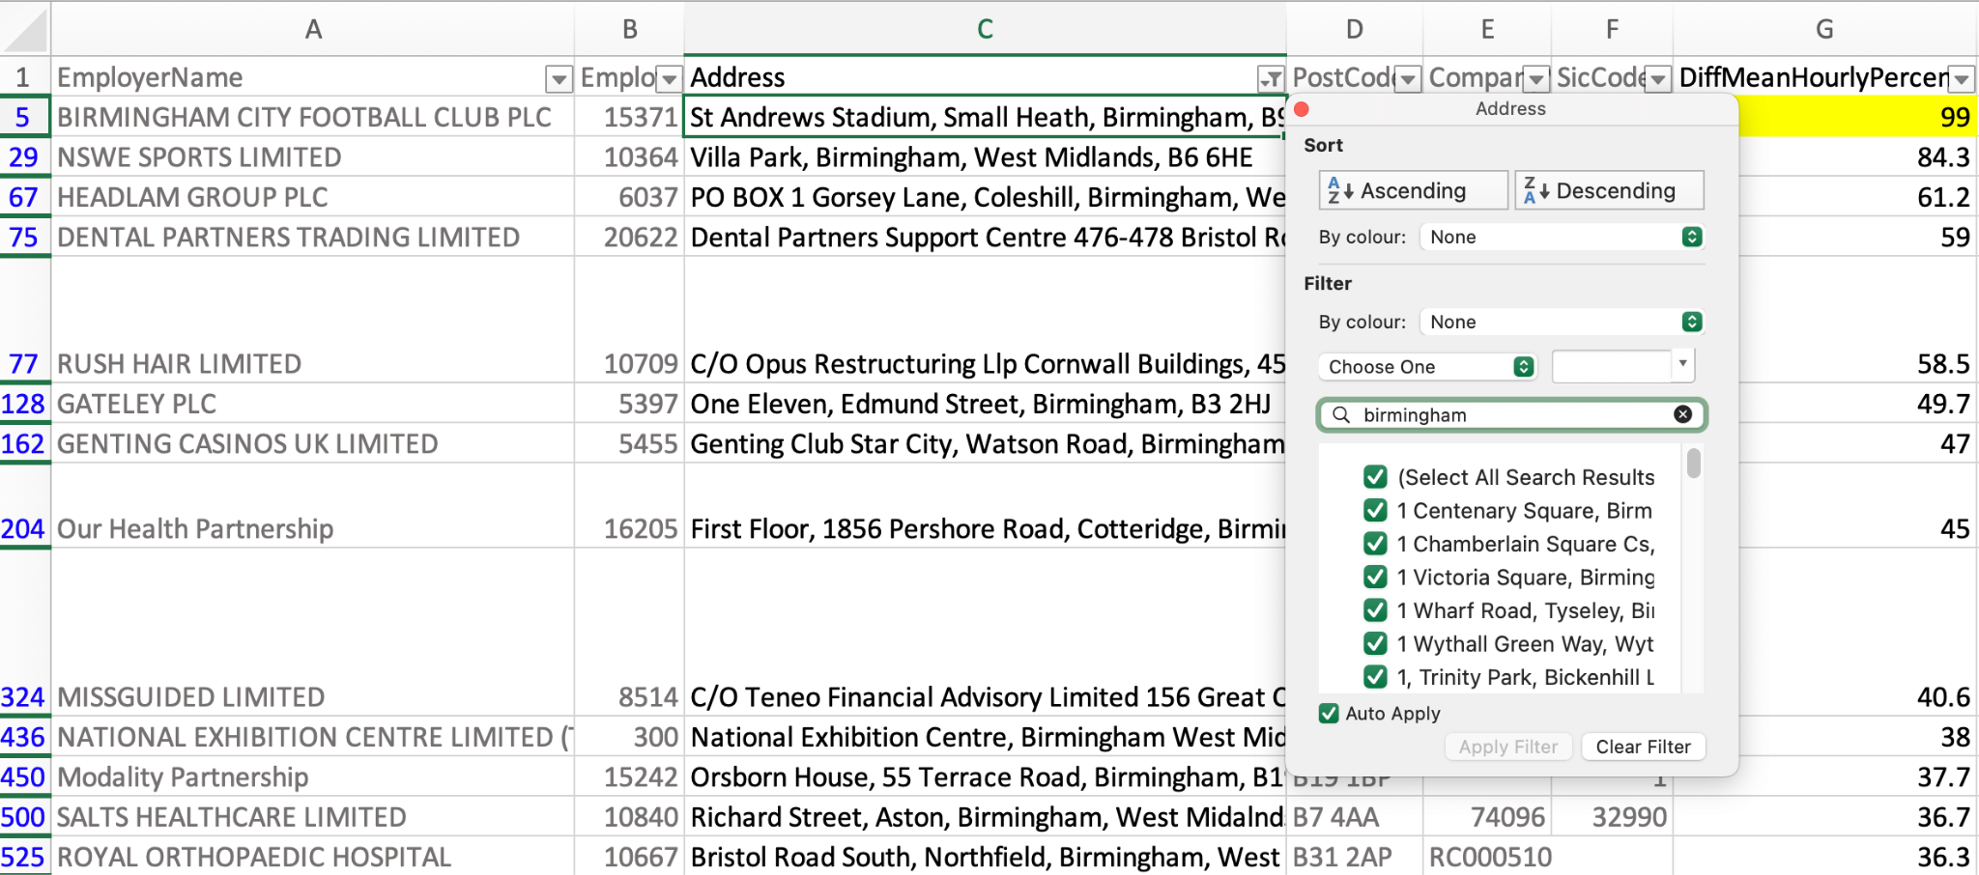
Sorted Z-A — and filtered
https://gender-pay-gap.service.gov.uk/

Slide 17
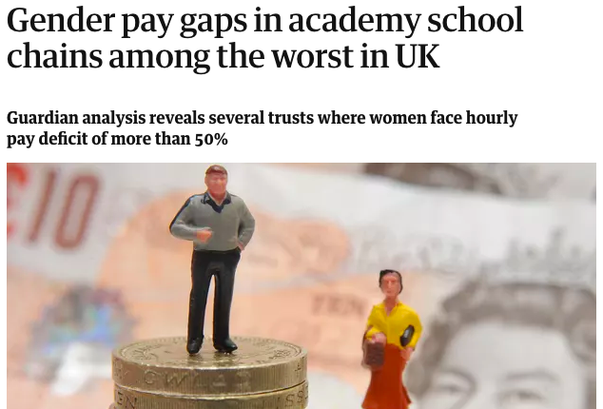
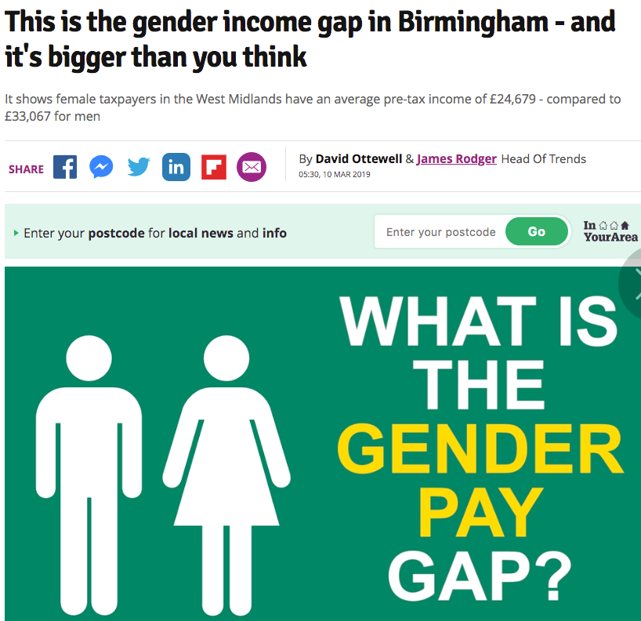
Filtering to reveal the scale/ranking in one category
https://www.theguardian.com/politics/2017/aug/10/gender-pay-gap-widening-at-one-in-four-government-bodies-figures-show
https://www.theguardian.com/news/2018/mar/25/gender-pay-gaps-in-academy-school-chains-among-the-worst-in-uk

Slide 18
Calculating to find stories
Divide change by the starting figure to get a percentage change
Divide the part by the whole to get a proportion (% of whole)

Slide 19
Calculating a proportion
73 companies out of 100 pay men more than women.
Divide the part by the whole: =73/100
= 0.73 (This means 73%)
Change formatting to show that as 73%

Slide 20
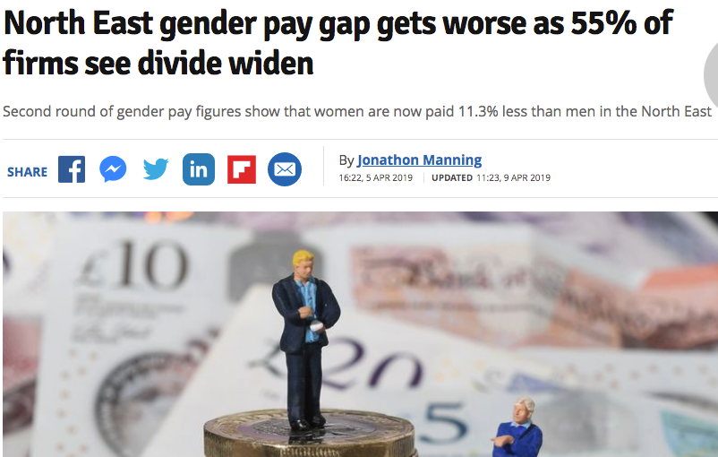
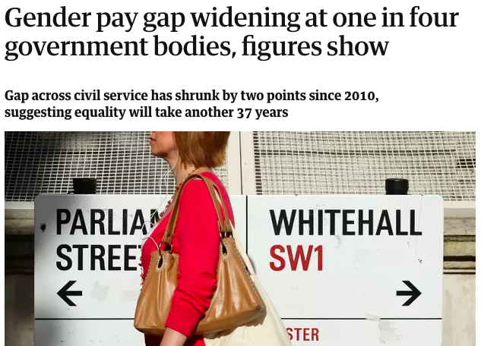
Calculating to reveal the scale (+ filtering = one category)
https://www.birminghammail.co.uk/news/midlands-news/gender-income-gap-birmingham-its-15940113
https://www.chroniclelive.co.uk/business/business-news/north-east-gender-pay-gap-16085565

Slide 21


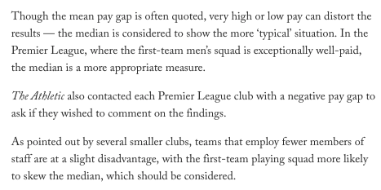
Exploratory feature: ranking across different measures
https://theathletic.com/4287505/2023/03/08/gender-pay-gap-premier-league/ (copy here)

Slide 22
Chapter 1: Ranking mean pay gap Z-A (Nottingham Forest have the largest gender pay gap)
Ch2: Ranking A-Z (West Ham’s gender pay gap shows a large advantage for female staff)
Ch3: Ranking on another column A-Z (Who employs the fewest women in the upper pay quartile?)
Ch4: Calculation then ranking (Which clubs have improved the most?)
https://theathletic.com/4287505/2023/03/08/gender-pay-gap-premier-league/ (copy here)

Slide 23
Tip: March 8 is International Women’s Day
Editorial planning:
Use as a topical hook for an exploration of data on gender pay gap in your field

Slide 24
Calculating a change
The number of companies paying men more than women rose from 53 to 73
Calculate the change: 73-53 = 20
Divide the change by the older figure: 20/53
= 0.38 (“increased 38%”)

Slide 25
Calculating a change (one org)
Pay gap at one club dropped from 75 to 25
Calculate the change: 25-75 = -50
Divide the change by the older figure: -50/75
= -0.66 (“dropped 66%” or “by two thirds”)

Slide 26
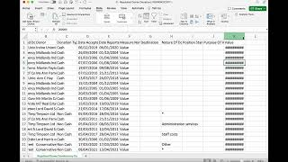
Video walkthrough: https://www.youtube.com/watch?v=MeTdQ-cloRw

Slide 27
Pitch what you have!
At this point it’s news: “data reveals” something. Try to pitch:
A ranking story
A scale story
A change story
What feature ideas might you pitch as a follow-up?

Slide 28
...And now for the power chord!
Pivot tables (what’s the big picture?)
*Only works with ‘granular’ data that can be aggregated in some way (e.g. categories, places, names appear more than once)

Slide 29
Understanding the data
Look for links on the same page
Follow the ‘breadcrumb trail’ of parent pages
Look for contact details in the data or related documents
Look for links on the website
Search around generally for docs, guidelines, methodology, experts

Slide 30
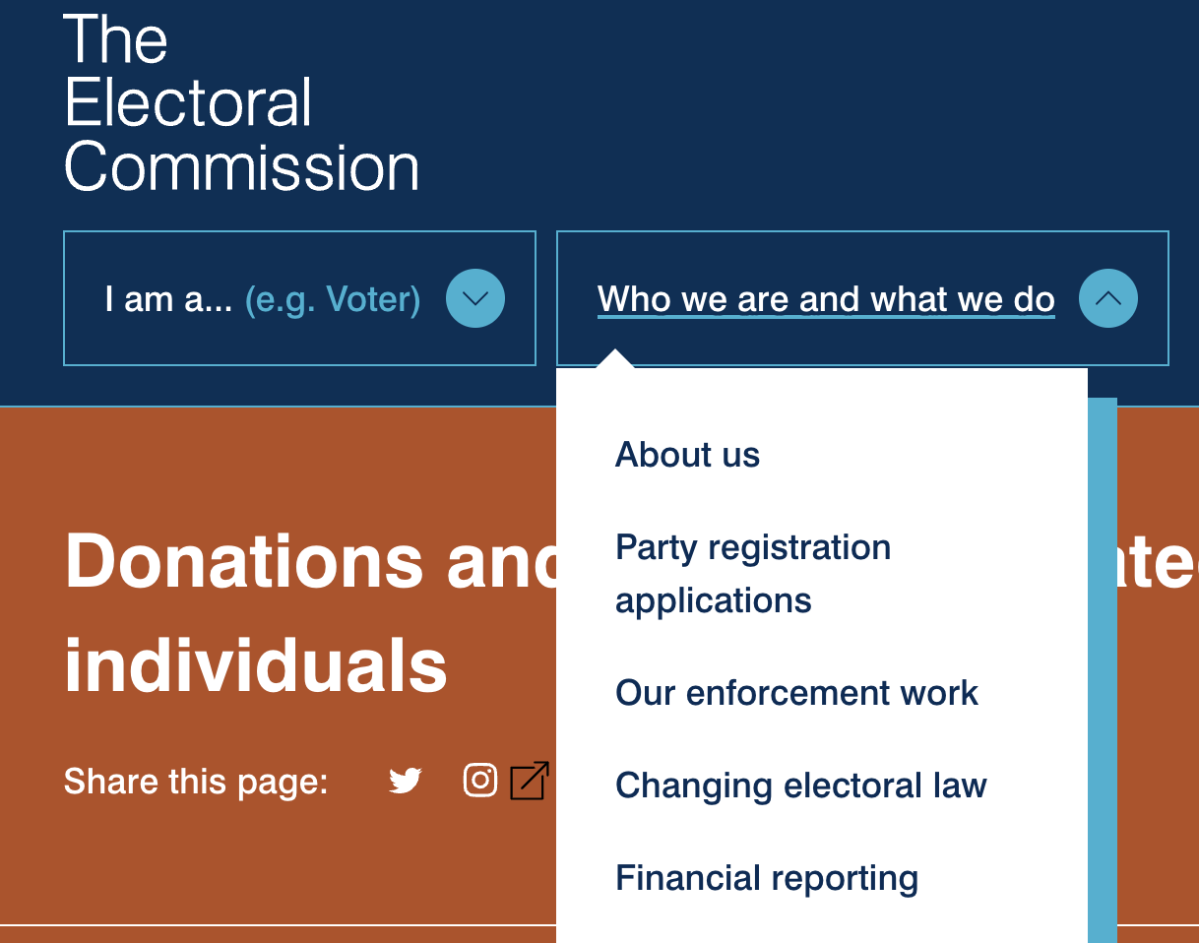

Slide 31
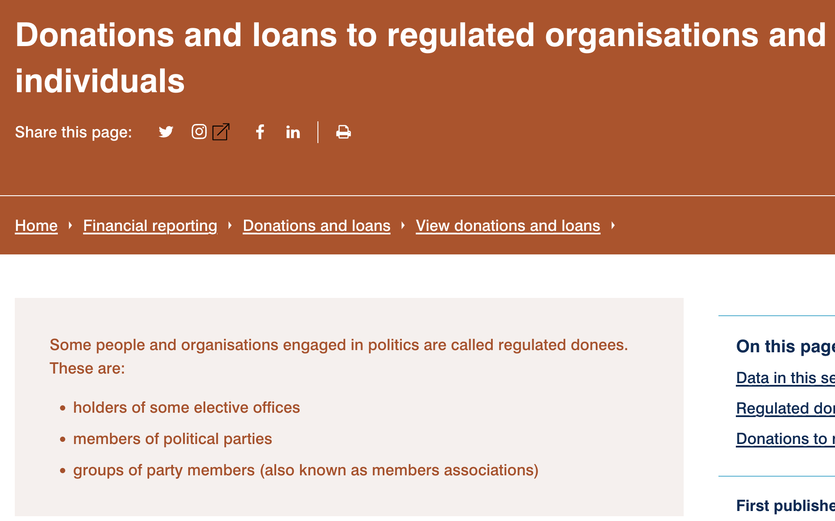
The ‘breadcrumb trail’
https://www.electoralcommission.org.uk/who-we-are-and-what-we-do/financial-reporting/donations-and-loans/view-donations-and-loans/donations-and-loans-regulated-organisations-and-individuals

Slide 32
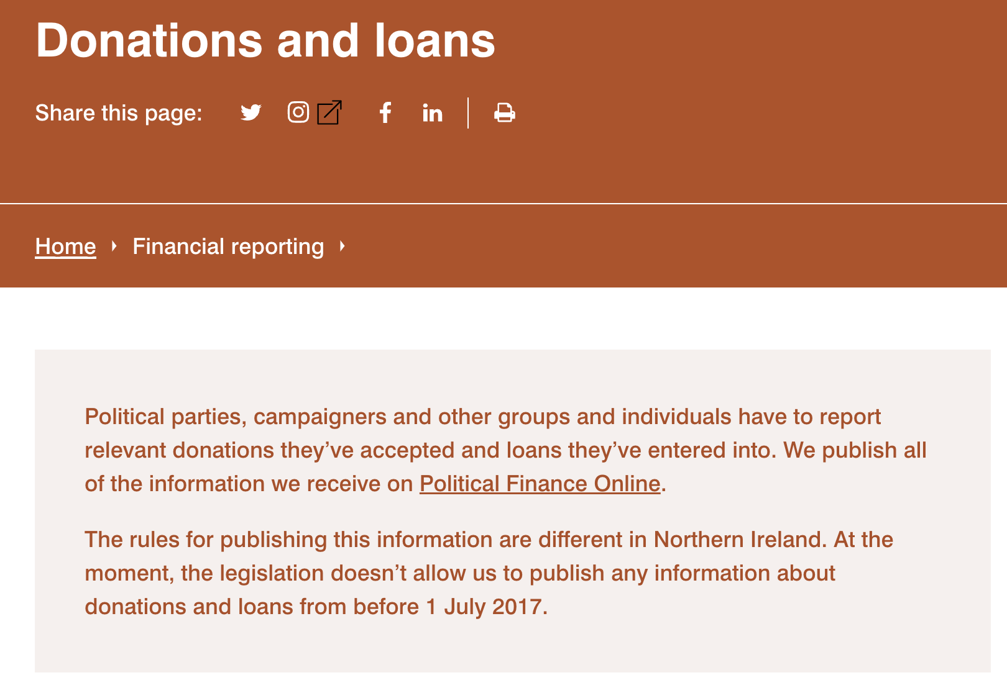
https://www.electoralcommission.org.uk/who-we-are-and-what-we-do/financial-reporting/donations-and-loans

Slide 33
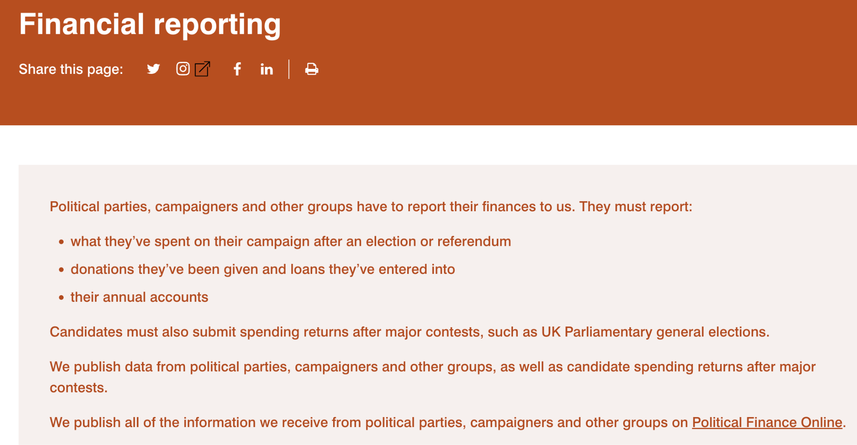
https://www.electoralcommission.org.uk/who-we-are-and-what-we-do/financial-reporting

Slide 34
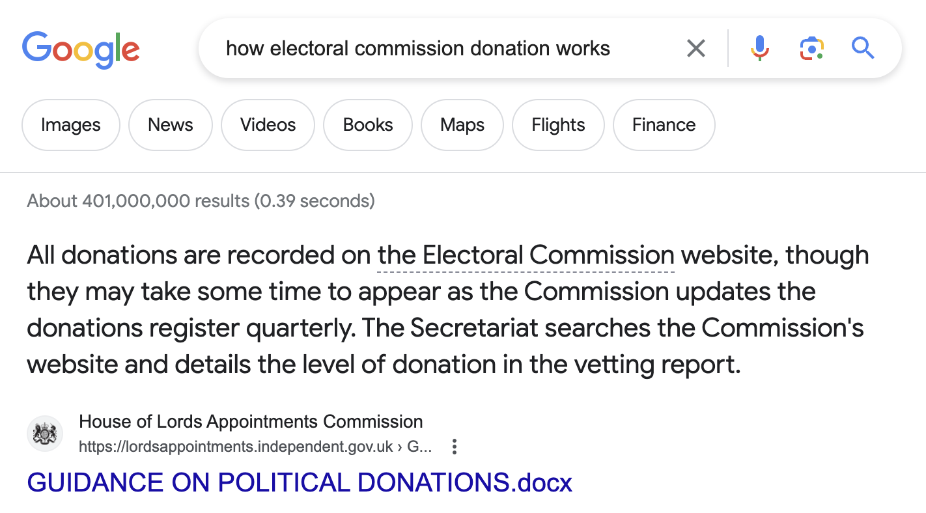


Slide 35
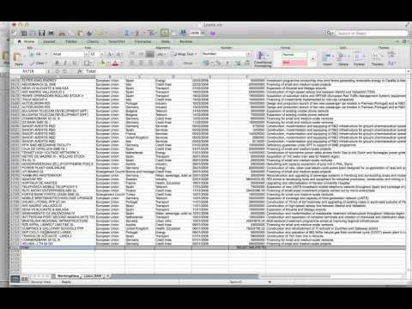
Getting data ready for interrogation: https://www.youtube.com/watch?v=MIMpL7QYO-I

Slide 36
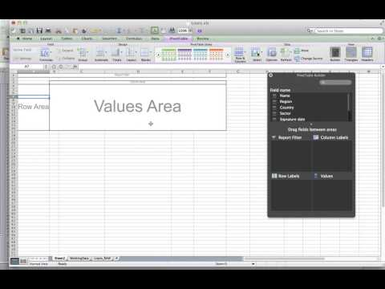
Pivot tables (again): https://www.youtube.com/watch?v=wKQznyIHOys

Slide 37
Can we pivot it?
Find some datasets on gov.uk etc.
Open them and explore
Identify the ones which can be ‘pivoted’, and those which are already pivot tables
Look for granularity and repetition (e.g. categories being repeated)

Slide 38
Directed study part 1:
Write a 2-3 paragraph news story based on the dataset (or another you choose)
Share your idea in Slack, discuss problems, and share the results once written. Help each other!

Slide 39

Watch this video lecture
before the next class

Slide 40
Directed study part 2:
Start reading Finding Stories in Spreadsheets (free copy link)
Optional: explore the New York Times’s training material on data journalism

Slide 41




Watching:

Slide 42
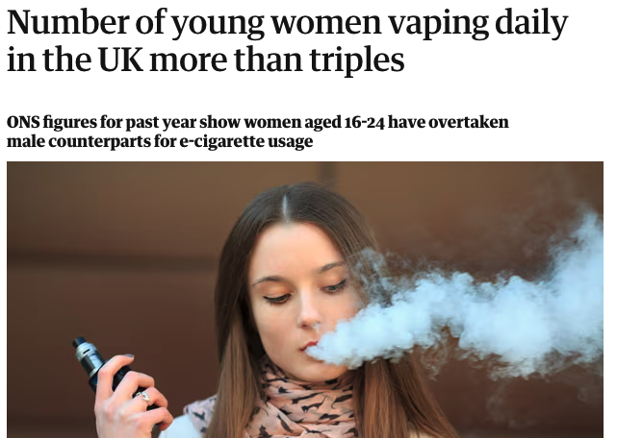
The number of young women vaping every day in the UK more than tripled in the last year, according to government figures.
Data released by the Office for National Statistics (ONS) showed that one in 15 women (6.7%) aged 16-24 vaped daily in 2022 – up from fewer than one in 50 (1.9%) in 2021 – with young women overtaking their male counterparts for e-cigarette usage.
The rise in young women vaping mirrors findings in an NHS survey of school-aged children last year, which showed more than one in five 15-year-old girls using e-cigarettes – hugely outstripping their male counterparts.
The first few pars of this are an example of simple data reporting

